Slide 1

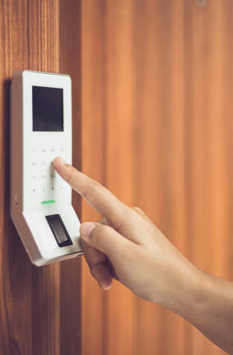
Password Based Door Locking System

Slide 2
Components Required
01
02
03
ARDUINO UNO BOARD
16*2 LCD DISPLAY
4*4 KEYPAD
04
05
SG90 SERVO MOTOR
BUZZER 5V

Slide 3
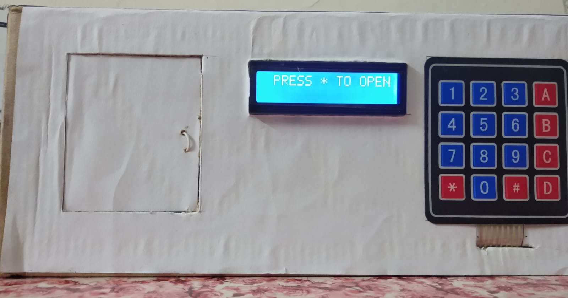

Slide 4
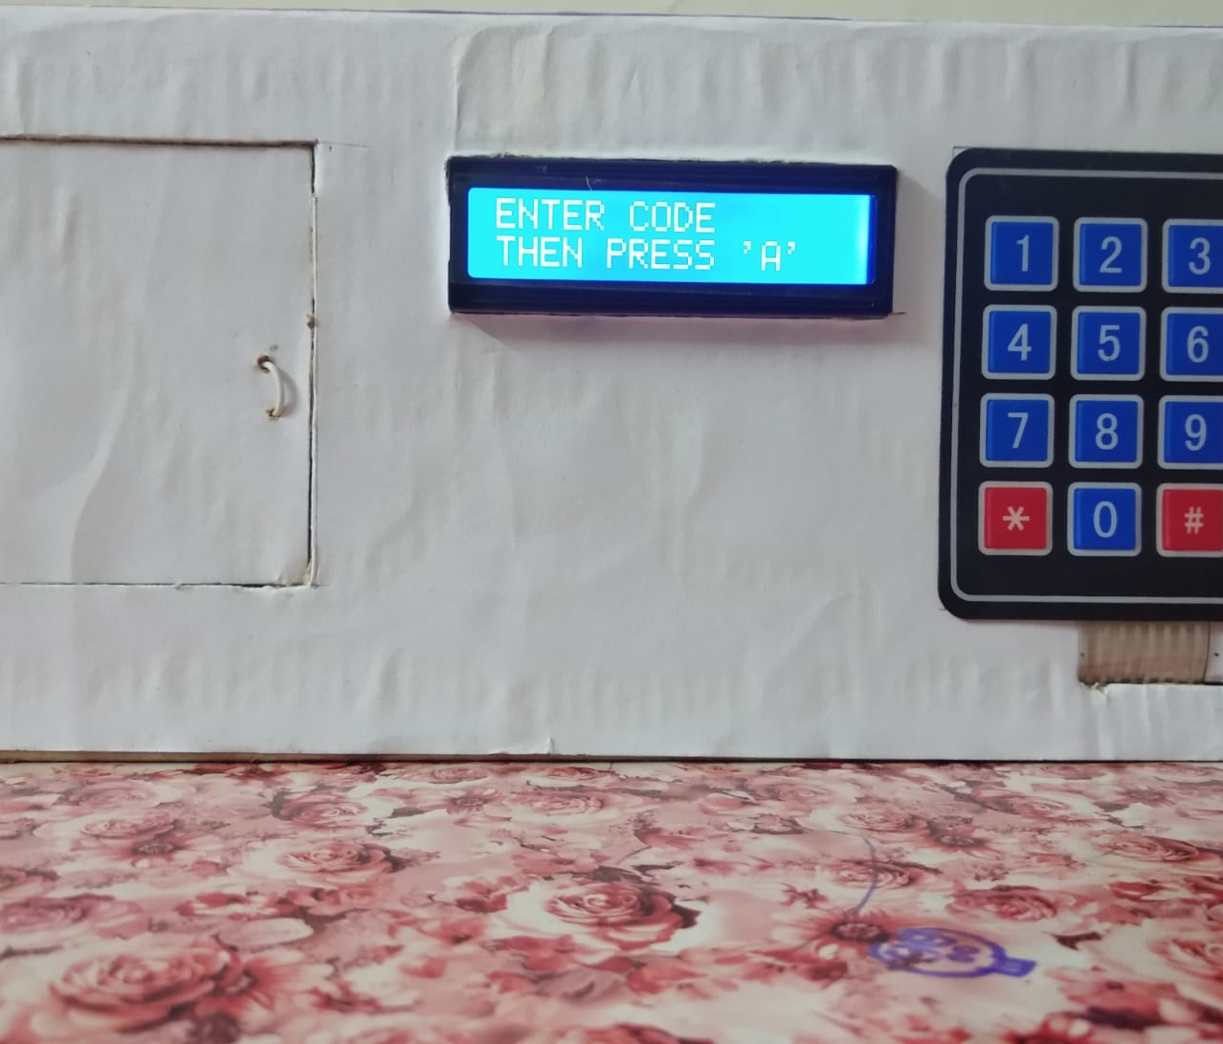
01
Enter password correctly To Unlock Door
Press ‘*’ to enter password and then press ‘A’ to continue

Slide 5
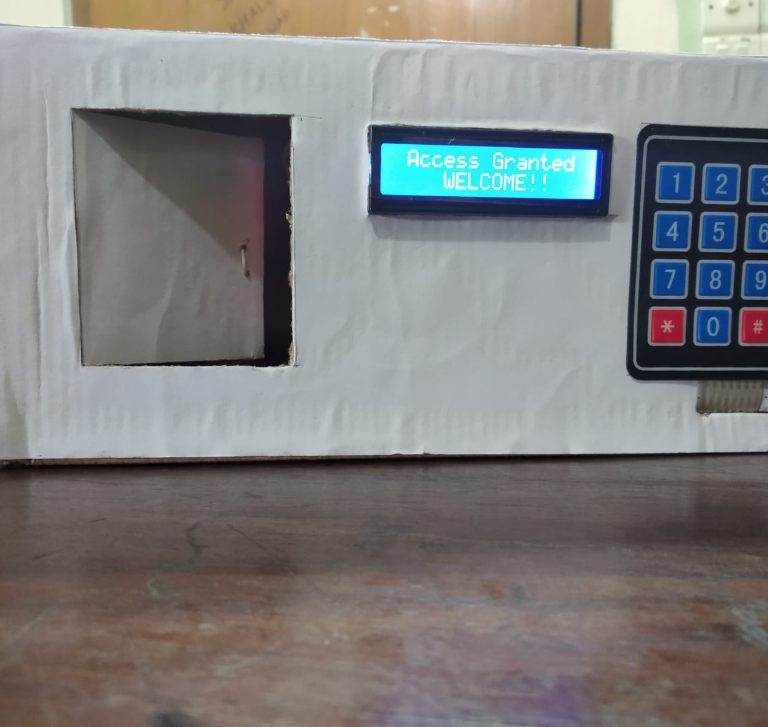
Servo
motor
rotates 120 degrees and unlocks the door

Slide 6
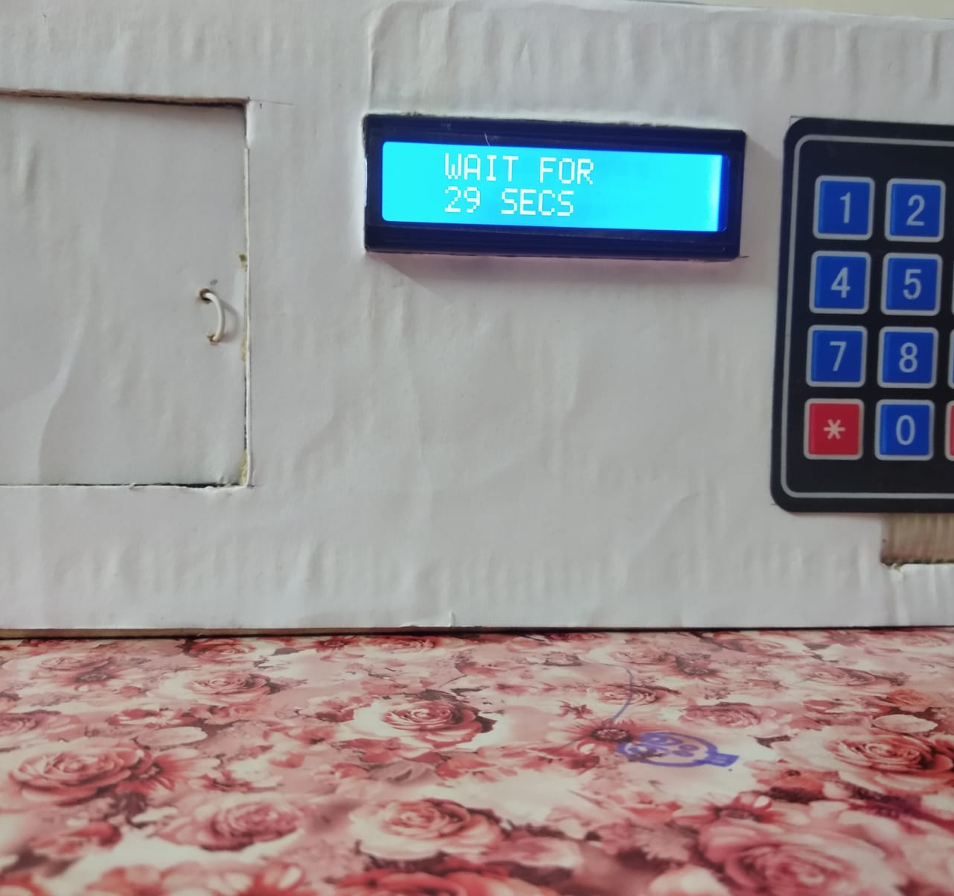
02
4 Incorrect
attempts
The buzzer sounds and the system freezes for 30 seconds.

Slide 7
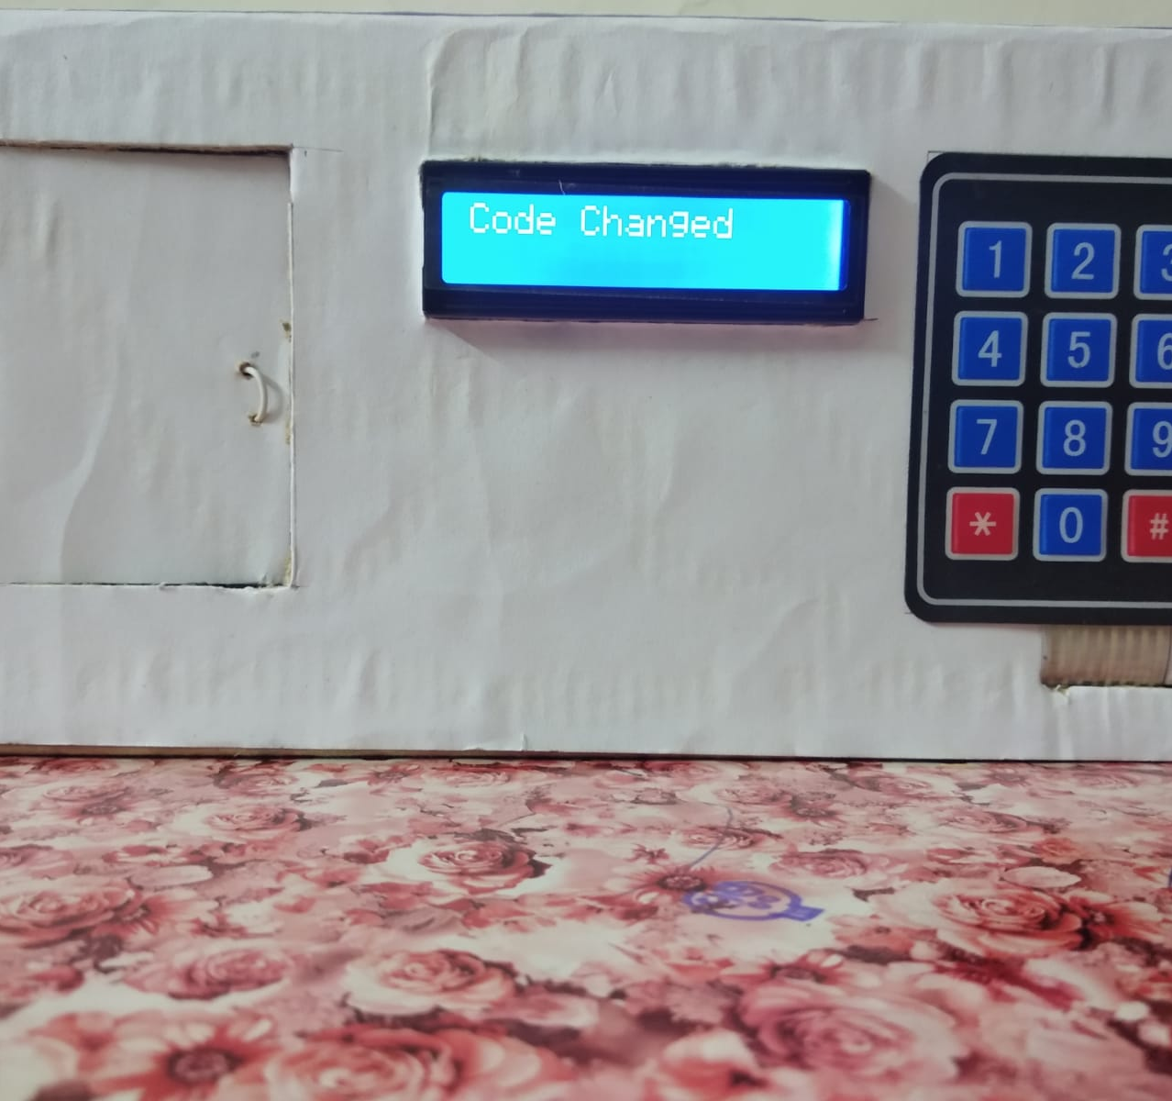
03
Change
Password
Press ‘#’ to change the old password

Slide 8
References
https://how2electronics.com/password-based-security-system-arduino-keypad/
https://iotprojectsideas.com/password-security-lock-system-using-arduino-keypad/
https://www.researchgate.net/publication/361265944_Password-Based_Smart_Door_Locking_System

Slide 9
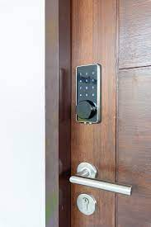
Thanks!

